Slide 1
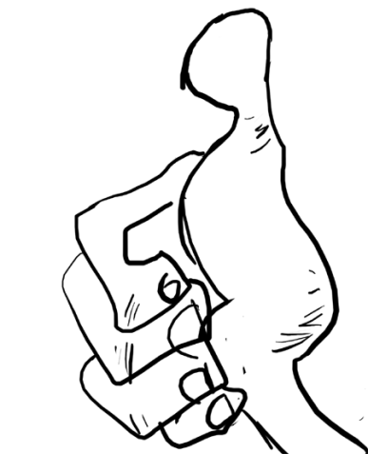
hǎo好
schaver.com
Informational resource
http://en.wiktionary.org/wiki/%E5%A5%BD

Slide 2
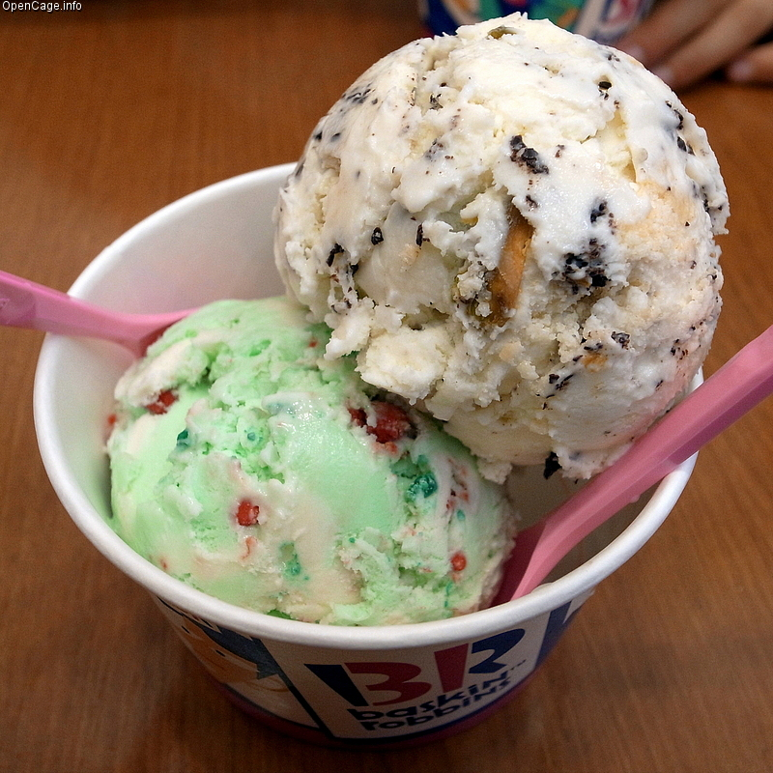
hǎochī好吃
schaver.com
http://nopsa.hiit.fi/pmg/viewer/photo.php?id=932516
http://opencage.info/pics.e/large_16404.asp

Slide 3
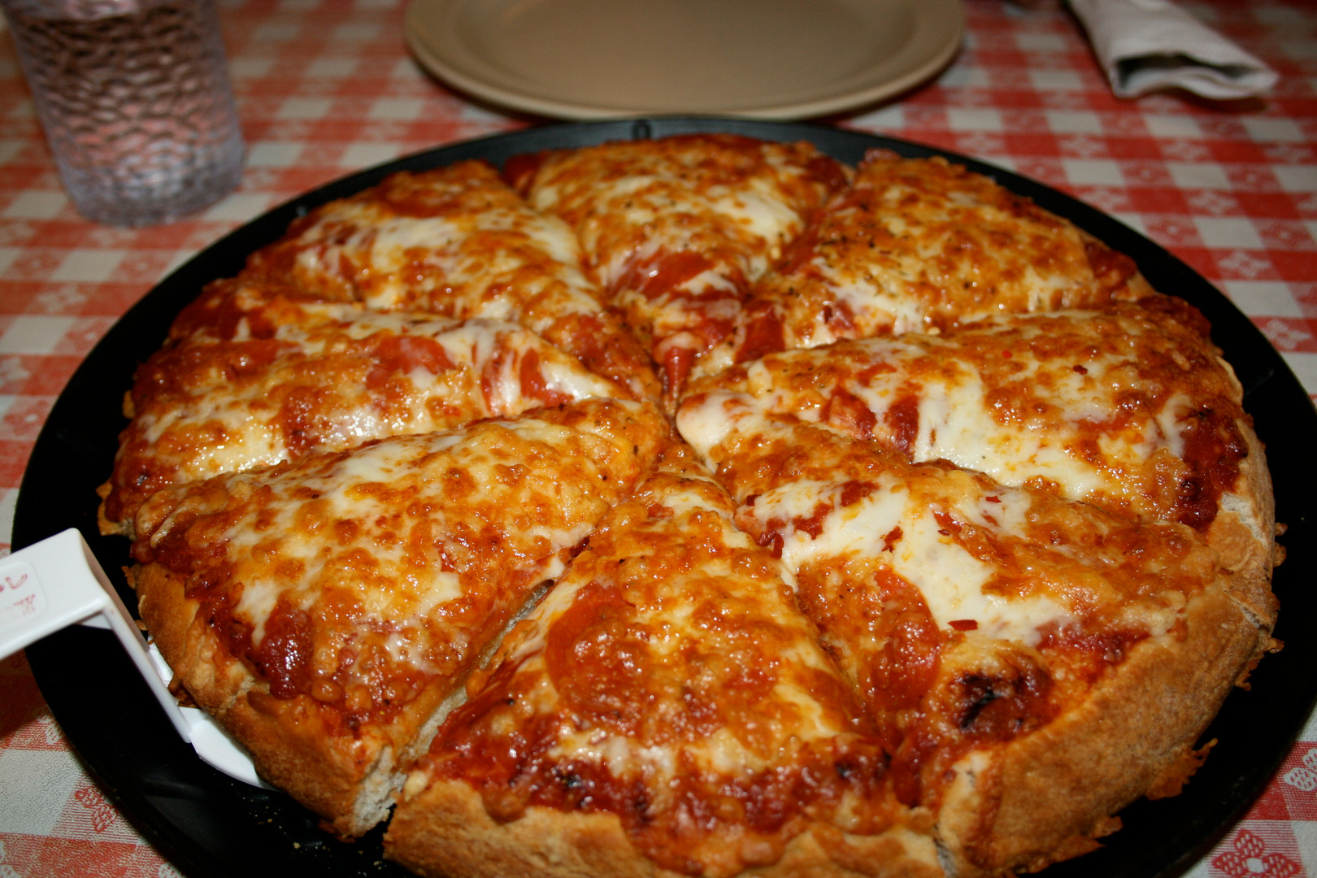
hǎochī好吃
schaver.com
fotopedia.com
http://nopsa.hiit.fi/pmg/viewer/photo.php?id=932516

Slide 4
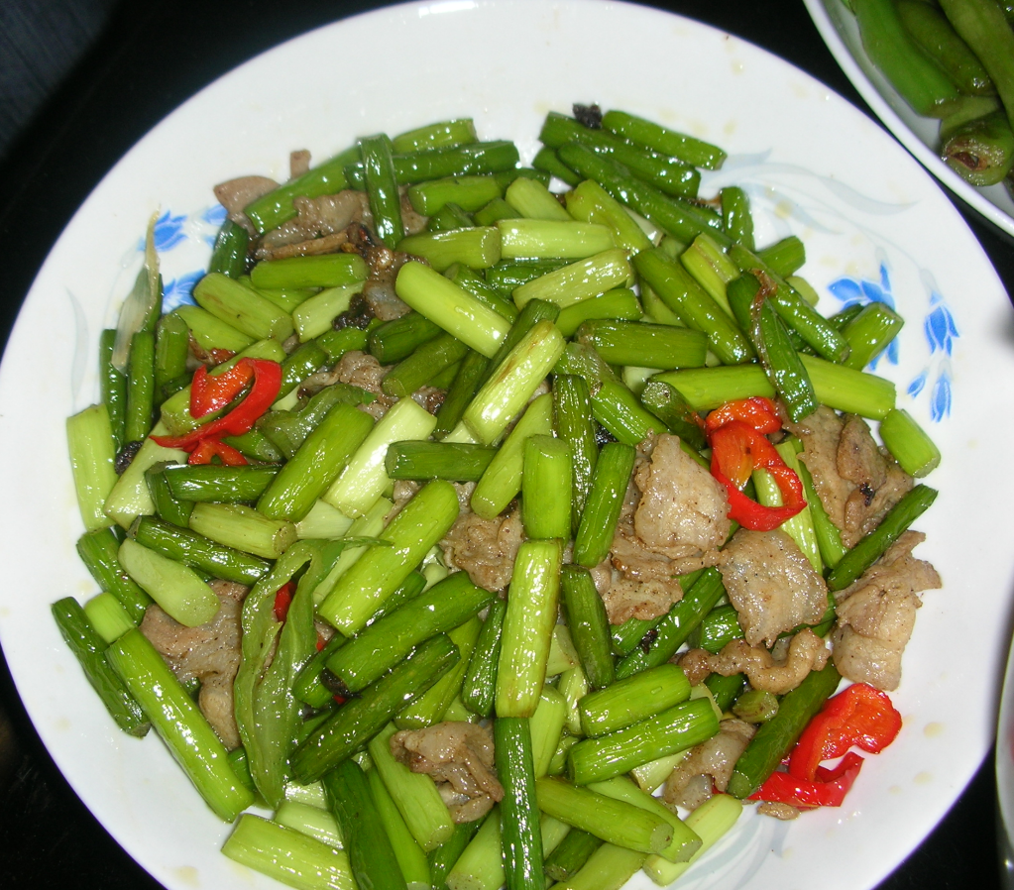
hǎochī好吃
schaver.com
http://nopsa.hiit.fi/pmg/viewer/photo.php?id=932516
capl.washjeff.edu

Slide 5
hǎohē好喝
schaver.com
http://nopsa.hiit.fi/pmg/viewer/photo.php?id=932516
suttonhoo.blogspot.com

Slide 6
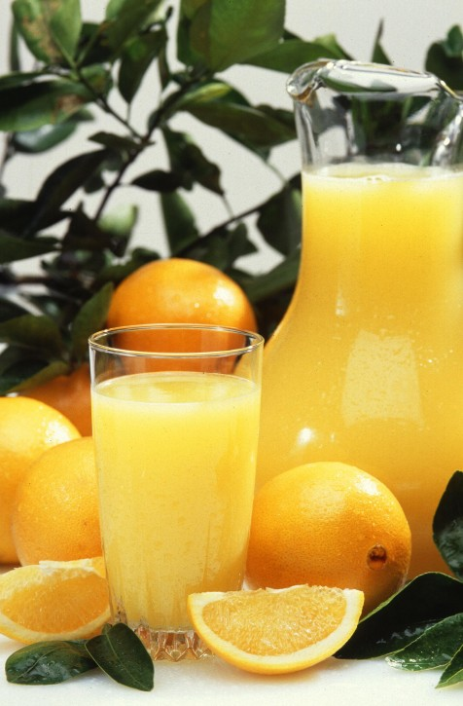
hǎohē好喝
schaver.com
http://nopsa.hiit.fi/pmg/viewer/photo.php?id=932516
public-domain-image.com

Slide 7
hǎohē好喝
schaver.com
http://nopsa.hiit.fi/pmg/viewer/photo.php?id=932516
sha3teely.com

Slide 8
hǎowán好玩
schaver.com
http://www.flickr.com/photos/wlodi/2254657082/
http://nopsa.hiit.fi/pmg/viewer/photo.php?id=932516

Slide 9
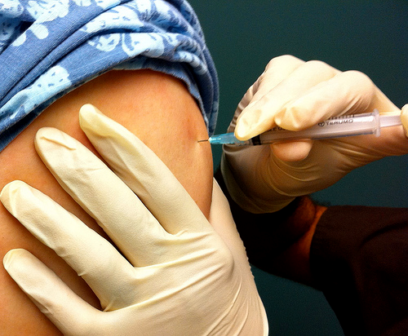
bùhǎowán不好玩
schaver.com
☹
nopsa.hiit.fi

Slide 10
hǎowán好玩
schaver.com
capl.washjeff.edu
http://nopsa.hiit.fi/pmg/viewer/photo.php?id=932516

Slide 11
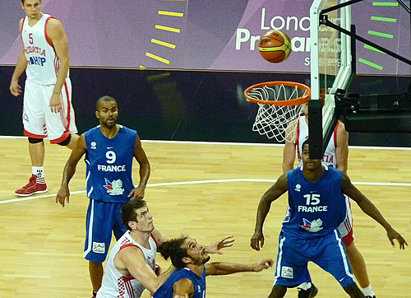
hǎowán好玩
schaver.com
http://www.flickr.com/photos/
http://nopsa.hiit.fi/pmg/viewer/photo.php?id=932516

Slide 12
hǎotīng好听
schaver.com
www.flickr.com/photos
http://nopsa.hiit.fi/pmg/viewer/photo.
cyberlawcentre.org

Slide 13
hǎotīng好听
schaver.com
nopsa.hiit.fi
www.flickr.com
http://nopsa.hiit.fi/pmg/viewer/photo.php?id=932516

Slide 14
hǎoxiě 好写
schaver.com
nopsa.hiit.fi
http://nopsa.hiit.fi/pmg/viewer/photo.php?id=932516

Slide 15
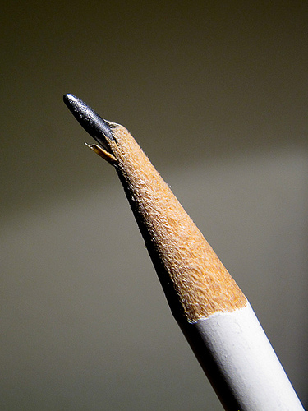
bùhǎoxiě 好写
schaver.com
☹
nopsa.hiit.fi

Slide 16
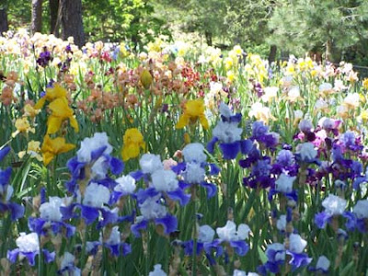
hǎokàn好看
schaver.com
moonstarsandpaper.blogspot.com
http://nopsa.hiit.fi/pmg/viewer/photo.

Slide 17
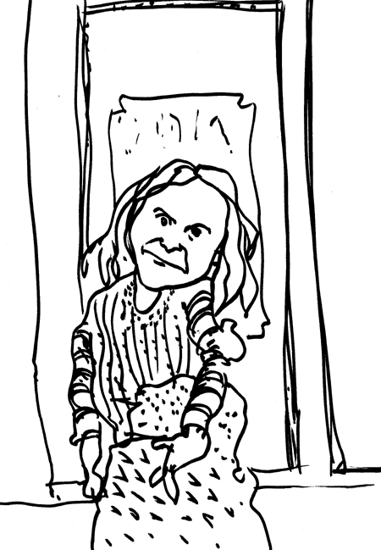
bùhǎokàn不好看
schaver.com
fotocommunity.com
schaver.com

